Slide 1
LandPro and Image Classification using Machine Learning
January 17, 2020

Slide 2
Brief Synopsis of Machine Learning
An algorithmic/statistical process by which a computer can learn patterns from and make inferences about a particular dataset in the form of mathematical models.
Machine Learning specifically relates to the process of a computer learning for itself what patterns and trends in a given dataset are relevant to its output. There is no human input to indicate what we might think is important.
There are hundreds of different types of machine learning models commonly used today, but the one type of model we've focused our efforts on for this image classification project is known as a Convolutional Neural Network (CNN).

Slide 3
Why a CNN?
Convolutional Neural Networks are especially well suited to computer vision tasks.
Images contain tens or hundreds of thousands of pixels that correspond to numeric values.
Most machine learning algorithms become exponentially more complex with large numbers of input values.
CNNs can quickly aggregate and accurately generalize patterns that it finds and search for those patterns throughout an entire image.

Slide 4
Proof of Concept Initially, we created a few basic CNNs to determine just how well they could learn to distinguish between 5 different Land Use Categories in Fulton County: Low Density Residential (111) Medium Density Residential (112)
High Density Residential (113) Commercial and Industrial (12)
Forest (40) We trained the models on approximately 6,000 images using images clipped to 5 acre lots.

Slide 5
Even with limited computational power and a relatively basic CNN structure, early results were quite promising, with accuracy above 80%.
Actual Category
 | 111 | 112 | 113 | 12 | 40
111 | 679 | 257 | 11 | 2 | 0
112 | 491 | 1894 | 308 | 39 | 0
113 | 1 | 9 | 71 | 1 | 0
12 | 1 | 2 | 4 | 204 | 5
40 | 10 | 2 | 9 | 11 | 1422
Predicted Category
Once Easting/Northing coordinates were incorporated into a subsequent model using the predictions from the CNN, accuracy improved to nearly 90%.

Slide 6
Ramping Up More for Images and Classifications
While the initial CNN model that we created was relatively straightforward, a more complex CNN model would likely provide the best results.
Computation time required to train CNNs increases substantially with model complexity.
GPUs (Graphics Processing Units) are far more efficient at performing the types of calculations used in machine learning algorithms than CPUs (Central Processing Units).
To date, transitioning to a machine with a suitable GPU for machine learning and taking the time to optimize the GPU for this project has likely saved 100-150 computer processing hours.

Slide 7
CNN Model Architecture Decisions
As noted earlier, a more complex CNN would likely provide better results since complex models are better suited for picking up on nuances in images rather than basic features such as colors and edges.
Computer vision research is a booming field with companies such as Facebook, Google, etc., investing a significant amount of resources into it.
There already exist numerous computer vision based CNN model structures that are available for use. No need to reinvent the wheel!
After much research, we decided to use 3 separate CNN architectures to see which would suit our needs best.
Our initial 5-layer network
Inception V3 (a 48-layer neural network)
Resnet50 (a 50-layer neural network with exotic architecture)

Slide 8
List of Land Pro Classifications
Due to lack of representation of certain categories, the Fulton County data set included images from 17 different Land Pro classifications:
111: Low Density Residential (3,743 images)
112: Medium Density Residential (8,356 images)
113: High Density Residential (1,589 images)
117: Multifamily Residential (721 images)
119: Mobile Home Parks (25 images)
12: Commercial and Services (1,081 images)
121: Intensive Institutional (544 images)
13: Industrial (99 images)
14: Transportation, Communication and Utilities (260 images)
15: Industrial and Commercial Complexes (1,378 images)
17: Other Urban (126 images)
171: Golf Courses (376 images)
172: Cemeteries ( 104 images)
20: Agriculture (1,992 images)
40: Forest (6,157 images)
60: Wetlands (84 images)
76: Transitional Areas (545 images)

Slide 9
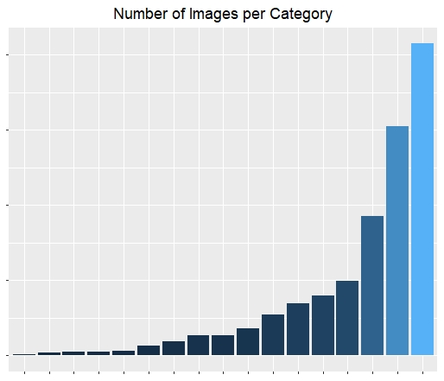
Class Imbalance
The number of images in each category ranges from 25 to 8,356.
Some Land Pro classifications are represented by less than 100 images for Fulton County.
Severe class imbalance and a small number of images to train with makes it difficult for models to correctly classify categories with less representation.

Slide 10
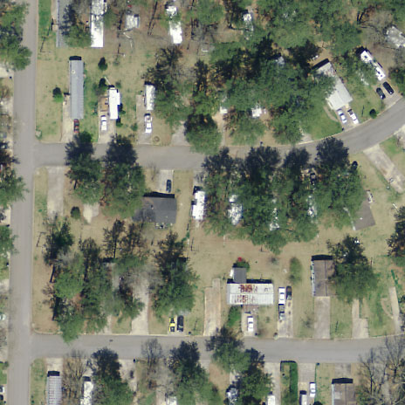
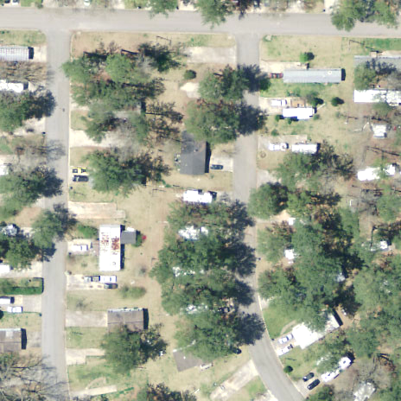
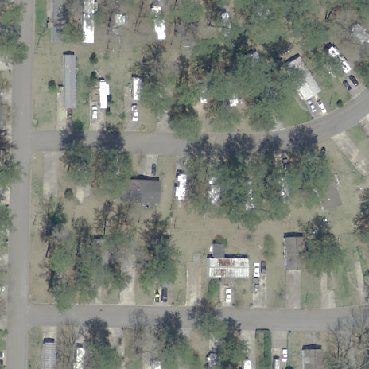
Augmenting our Image Set
We can increase the number of images in categories with low representation by slightly altering the images en masse to produce new images that still represent the category but with enough variance for the model to learn new patterns from.
Rotated, Dimmed, Desaturated, Blurred
Original
Rotated, Brightened

Slide 11
Initial Testing and Results
Initially, all 3 models were trained on 100 images per category as a preliminary testing exercise.
Our original model structure and the Inception V3 structure achieved approximately 30% accuracy.
The ResNet50 model achieved only 25% accuracy, though this was not a surprise given that research has shown that this particular model struggles with low numbers of image inputs.
For comparison, similar tests during the Proof of Concept phase with 5 categories yielded over 50% accuracy.

Slide 12
Increasing the Sample Size from 100 to 1000
Initial testing essentially confirmed what we already know. The models needed more images to learn from than just 100 per category.
We further augmented the image set so that there were at least 1000 images available for each category.
We randomly selected 1000 images from highly represented categories (this is commonly referred to as Random Undersampling).
While 1000 images might seem to be an arbitrary number, it is actually a figure that is well supported by research.

Slide 13
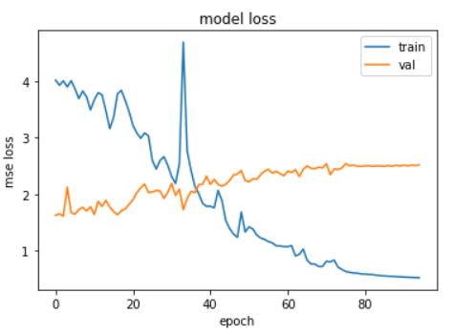
Overfitting on Larger Image Set
Overall Accuracy on an image set consisting of 1000 images per category for our original model and InceptionV3 was approximately 50%. ResNet50 was slightly higher at 55%. It was readily apparent that the results were due to Overfitting.
Overfitting is a scenario where the model learns too many nuances on images it sees (represented by the blue line) and doesn’t develop the ability to generalize on new images it didn’t learn from (represented by the gold line). The term “loss” refers to just how far off the model’s predictions are.

Slide 14
Potential Causes of Overfitting
Incorrect application of metrics that the models use during the training process to penalize themselves when they are incorrect. This is rectified by a process called Regularization.
The models are “looking too closely” at the images and are picking up too many details from them when they should be trying to generalize what they see. We can force them to “squint” by a process called Layer Dropout.
Model architectures that are too complex will often struggle if the patterns they are looking for are not as nuanced as the ones that the models were originally created for. But even our simple base model suffered from overfitting.
None of these were the cause of the problem. By process of elimination, that indicates that the images themselves are the source of overfitting.

Slide 15
How Images Cause Overfitting
The original classification process relied on using contextual information to make decisions about adjacent regions.
The models have no way of knowing that contextual information just by looking at images.
Many images from a range of categories are very difficult to classify while only looking at individual, 5 acre plots.
When there are no obvious patterns to learn, the model will still attempt to mathematically justify the differences among each category.
In order to do that, models will often pick up on arbitrary and irrelevant patterns in images and make decisions based on those.

Slide 16
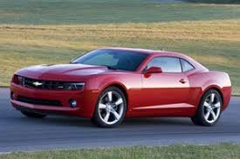
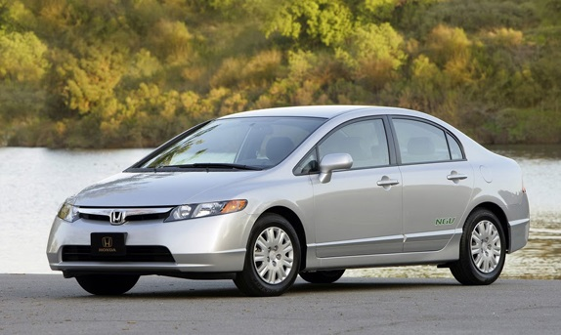
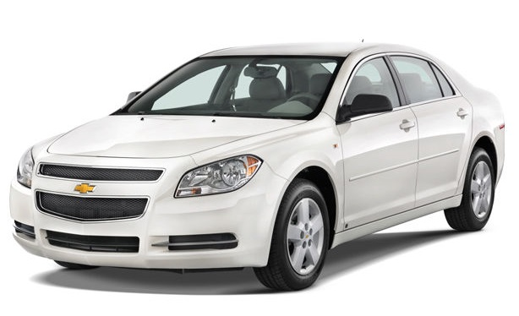
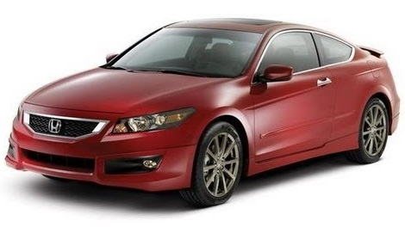
Basic Example of Arbitrary Inferences
ü
ü
ü
Cars can be red with 2 doors and a green background
Cars can be silver but only if there’s water nearby
Cars can be white but only if there’s a white background
✘
NOT A CAR! Cars can only be red with a green background or white with a white background!

Slide 17
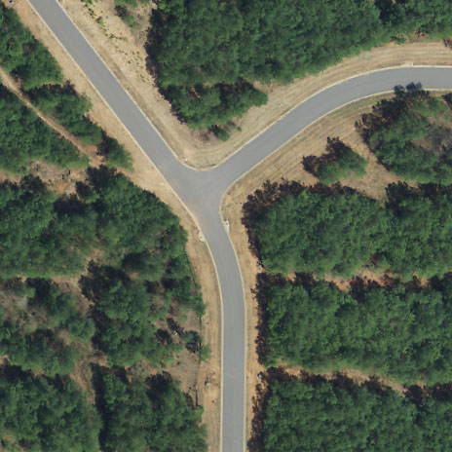
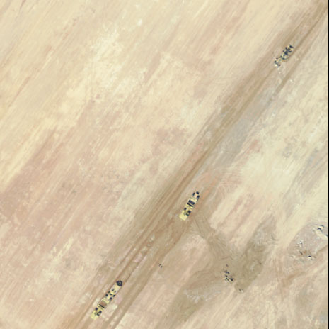
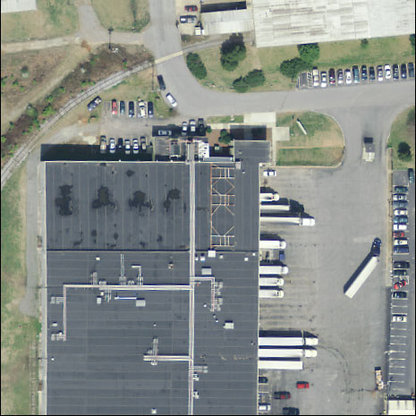
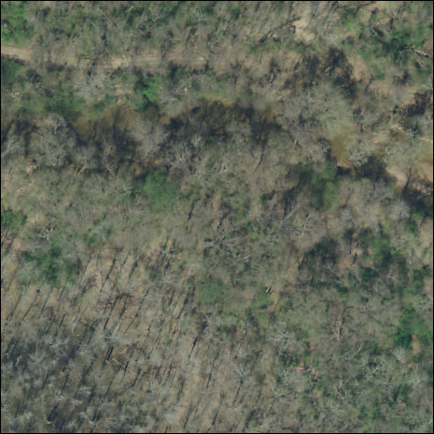
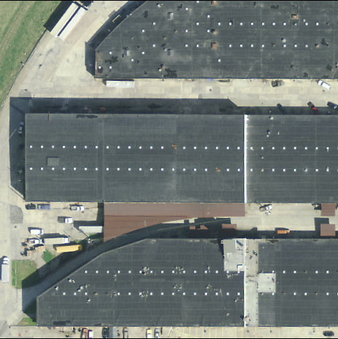
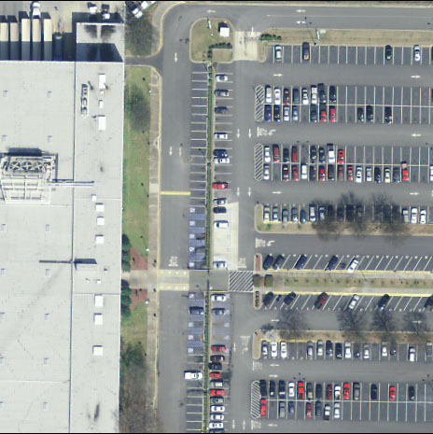
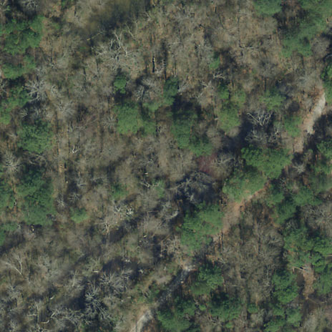
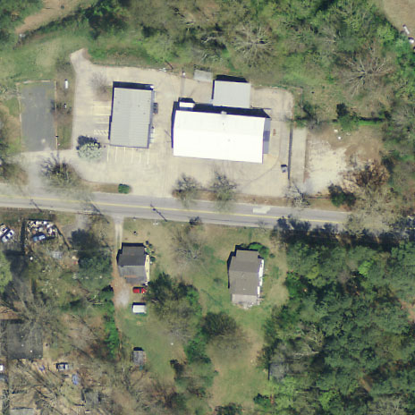
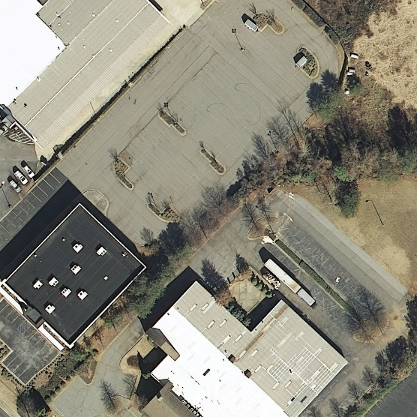
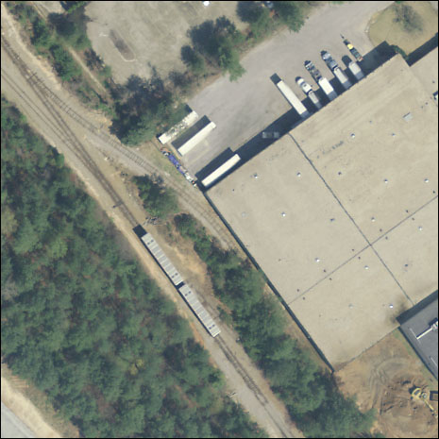
Randomly Selected Images From Difficult to Classify Categories

Slide 18
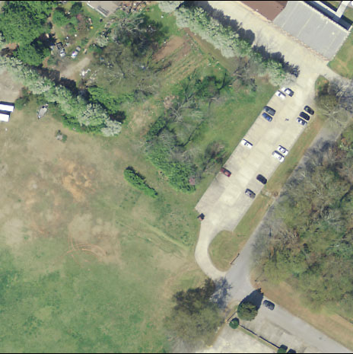
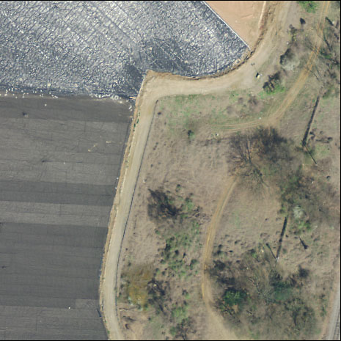
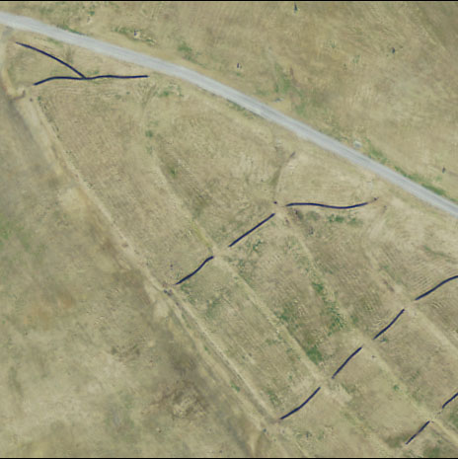
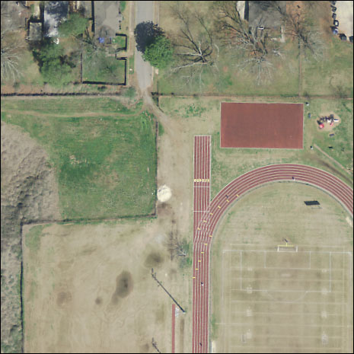
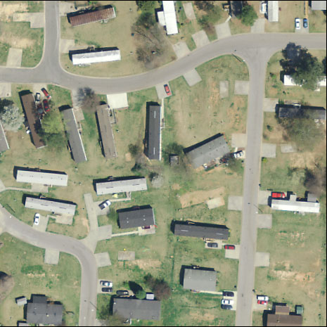
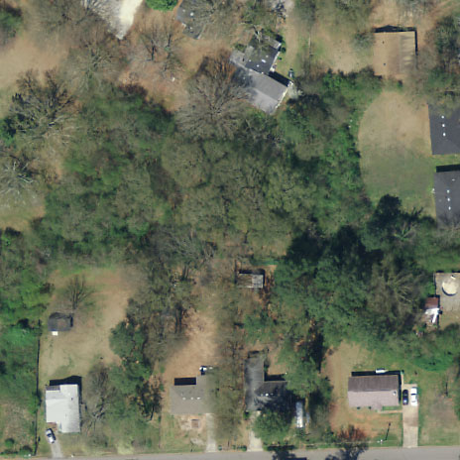
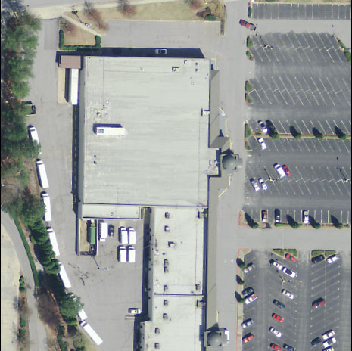
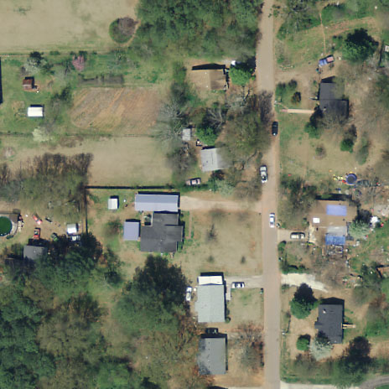
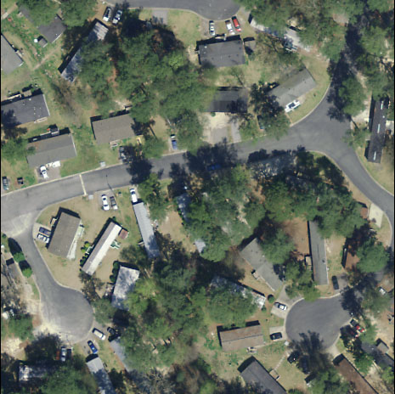
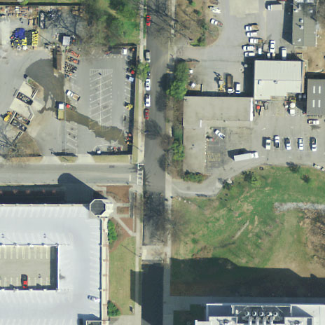
More Randomly Selected Images

Slide 19
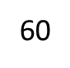
Randomly Selected Images – Classified
76
76
13
15
13
60
12
12
15

Slide 20
More Randomly Selected Images - Classified
121
17
17
121
119
112
121
112
119
121

Slide 21
Several Viable Solutions To Consider
Implementation of parcel and/or Easting and Northing data into the model
Recurrent adjacency analysis
Selective sampling
Hierarchy of models for similar classifications
Object detection analysis of images with smaller scale
Combination of methodologies listed above

Slide 22
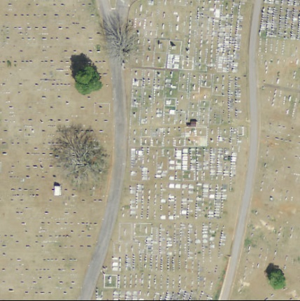
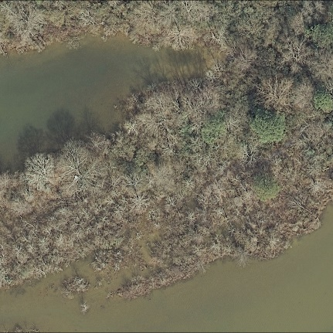
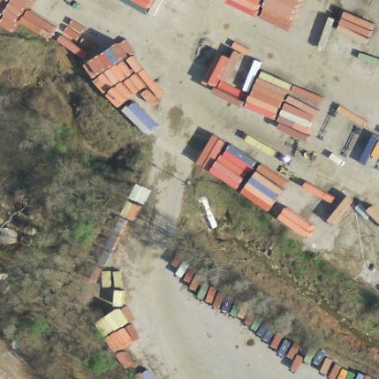
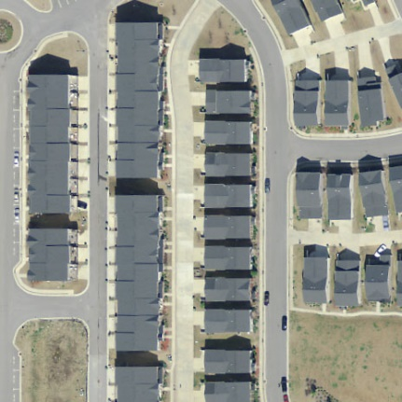
Parcel Data and Easting/Northing Coordinates
Parcel data would greatly help in distinguishing between residential densities.
Simple is better. If parcel data alone can accurately identify residential classifications, then there would be no need to train a CNN to learn about them.
Adding a subsequent model that implemented Easting/Northing data to our Proof of Concept reduced the number of errors by 40%.
The model can learn what categories are/aren’t commonly found near each other. You don’t see many cemeteries next to wetlands!

Slide 23
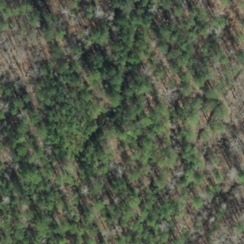
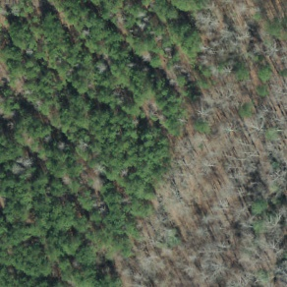
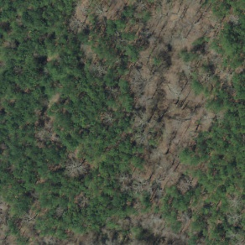
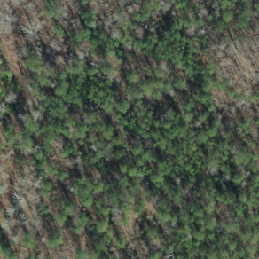
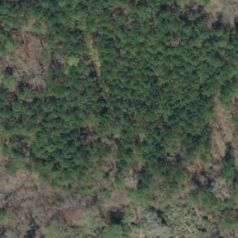
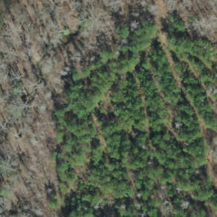
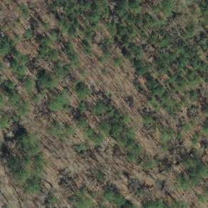
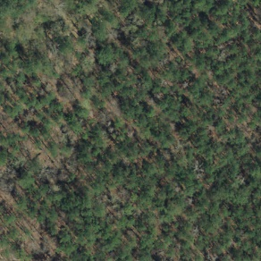
Adjacency Analysis
Similar to Easting and Northing data, an adjacency analysis would help to provide the models with contextual data about the regions of land immediately surrounding each image.
The outputs from the CNN could be fed into a subsequent model that looks at the outputs for a given image as well as the 8 images nearest to it.
?

Slide 24
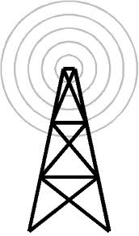
Selective Sampling
For most of the primary model training processes, we used 1000 RANDOMLY selected images from each classification.
Selective Sampling is a method of image selection that allows us to pick and choose which images we want the models to learn from.
Preliminary results from this have been quite promising. With 100 selected images per category, we are approaching 50% accuracy. That’s similar to what we achieved in the Proof of Concept with the same number of images.
Think of the model as a radio antenna, and the defining imagery of each category as the signal. We want to provide the model with the strongest signals possible so that it picks up on what we want it to.

Slide 25
Implementation of Model Hierarchy
All Classifications
Residential
Low Density
Medium Density
Industry
Ag
High Density
Mobile Homes
Natural
Forest
Wetland
Trans, Comm, Utils
Industrial
Ind and Comm
By categorizing similar classifications under one large heading, we can create a model to distinguish between fewer major classifications and then create subsequent models to make finer distinctions.

Slide 26
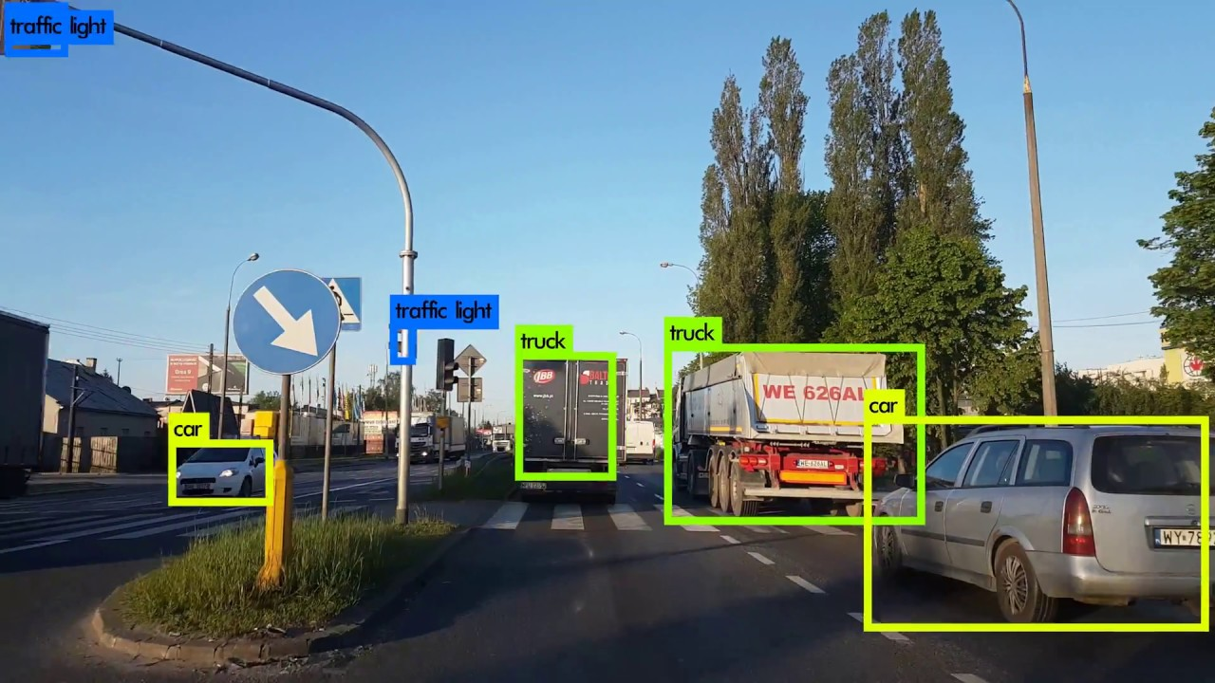
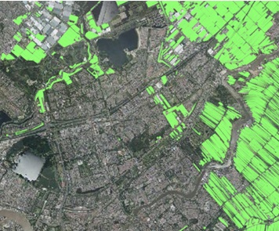
Object Detection on Smaller Scale Imagery
Object detection is a method where a computer model attempts to identify specific features in an image. This is commonly used in self driving cars, facial recognition, etc. This method is more closely resembles the manual process of drawing polygons to delineate regions of differing usage.
Object Detection in a Self Driving Car (Left)
Detecting forested regions in a city (Right)

Slide 27
Expert Input is Very Helpful!
The best computer models are created when subject matter experts and machine learning programmers work together to come up with methods and algorithms that are specifically suited to the data.
Being the experts on these images and knowing specifically how and why they are classified the way they are, you are uniquely suited for coming up with ideas that can be implemented.
Comments and feedback are not only welcome, but also greatly appreciated.

